Slide 1
How to monitor yourself for free (well kind off)
Eric Leahy Sr. Network Engineer
Daniele Vazzola Principal Infrastructure Engineer

Slide 2
Content
Building a monitoring tool
Eric Leahy
2000 Eyes
Daniele Vazzola

Slide 3
Building a monitoring tool

Slide 4
Every solution starts as a problem….

Slide 5
So what was our problem?

Slide 6

Customers being your alerting tool is bad!

Slide 7


Slide 8
We needed better monitoring & verification

Slide 9


Build or Buy

Slide 10
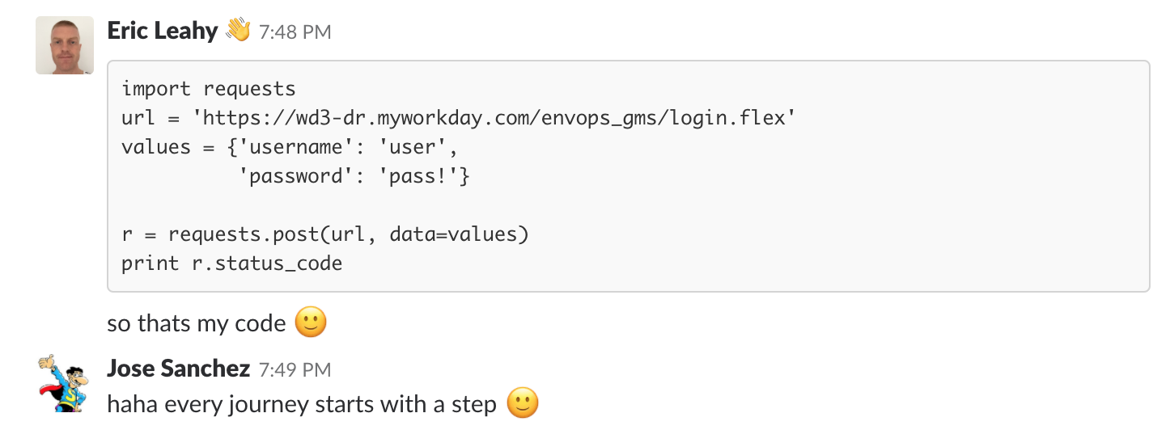
Automation can help

Slide 11
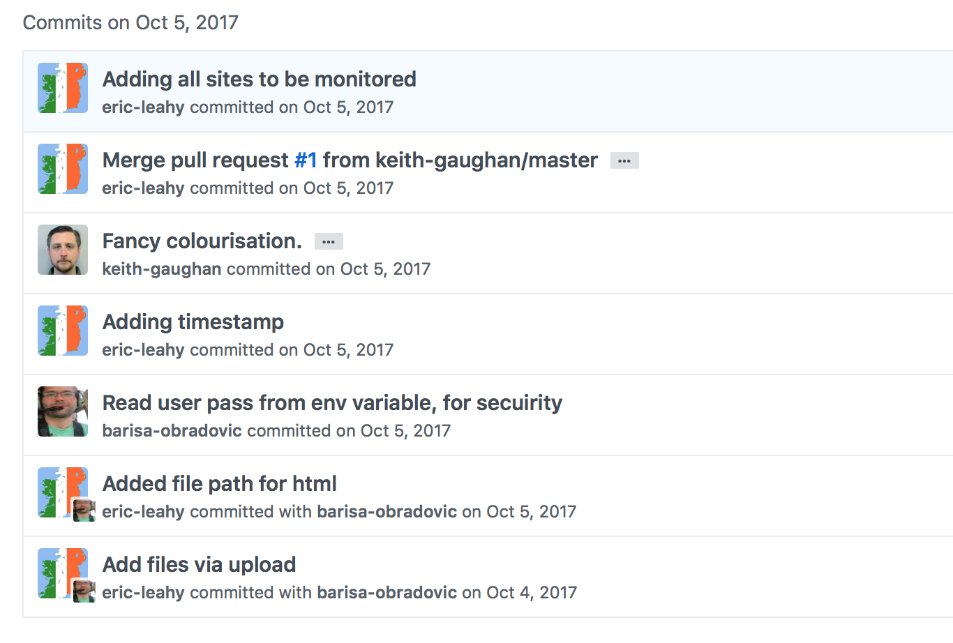
Remember I am not a coder…..

Slide 12
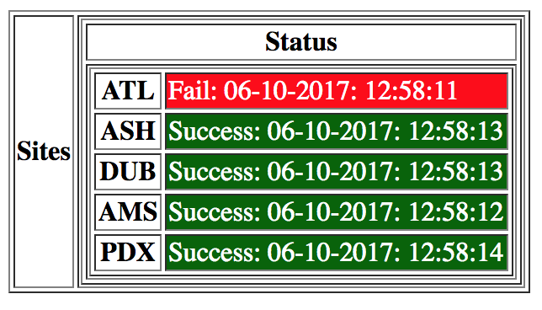
First dashboard

Slide 13

What about historical view?
What about multiple test locations?

Slide 14


Time Series databases

Slide 15
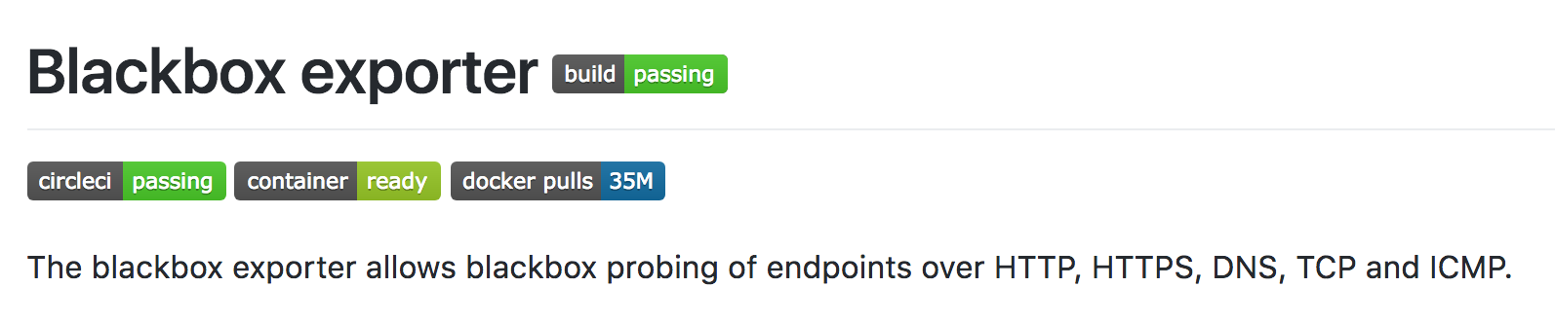
Prometheus it is then...
https://github.com/prometheus/blackbox_exporter

Slide 16


Prometheus Collector
Blackbox_Exporter
Blackbox_Exporter
Blackbox_Exporter

Slide 17
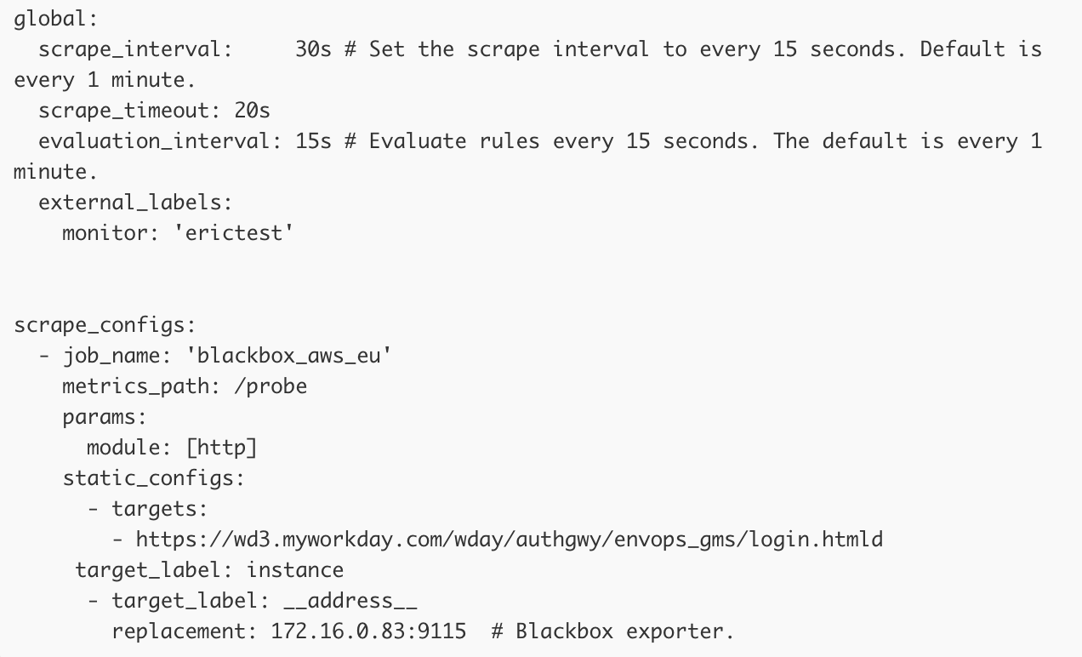
Prometheus Config

Slide 18
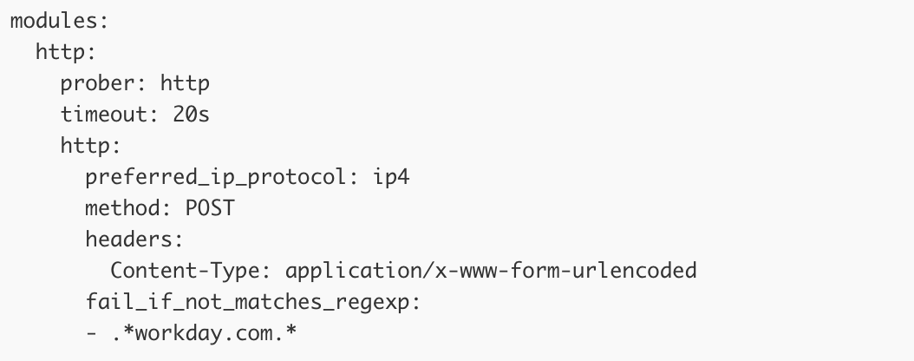
Blackbox_Exporter Config

Slide 19
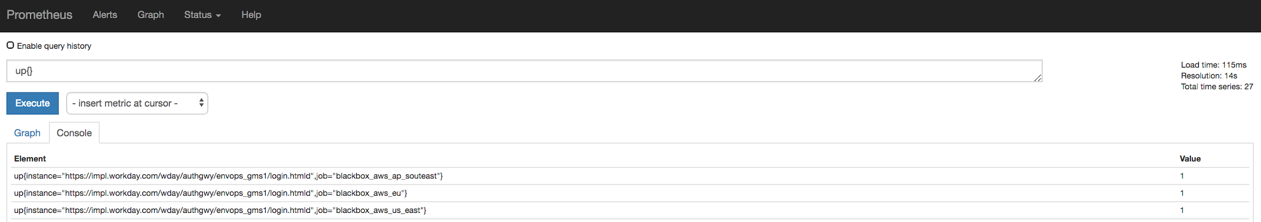
It Worked!!

Slide 20
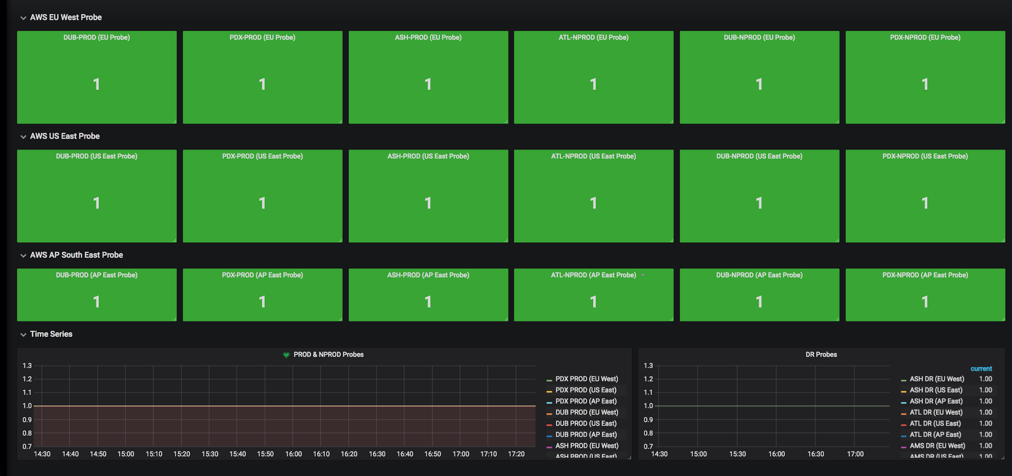
Making it pretty

Slide 21
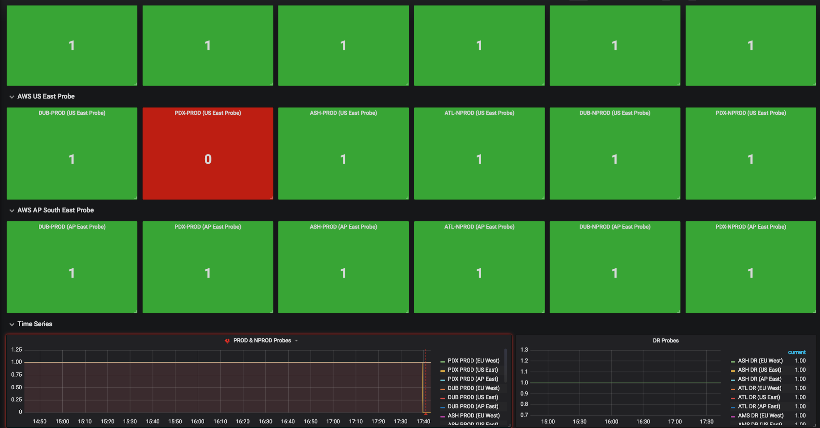
False Positive

Slide 22
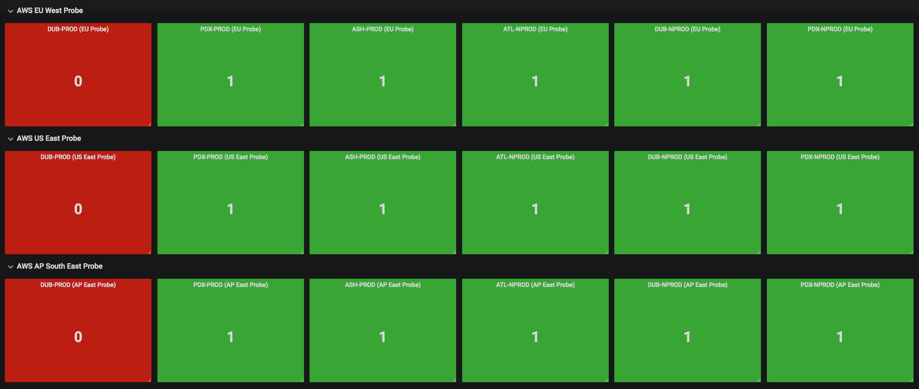
It’s DOWN!!

Slide 23
How much?
$40 a month

Slide 24
2000 Eyes

Slide 25
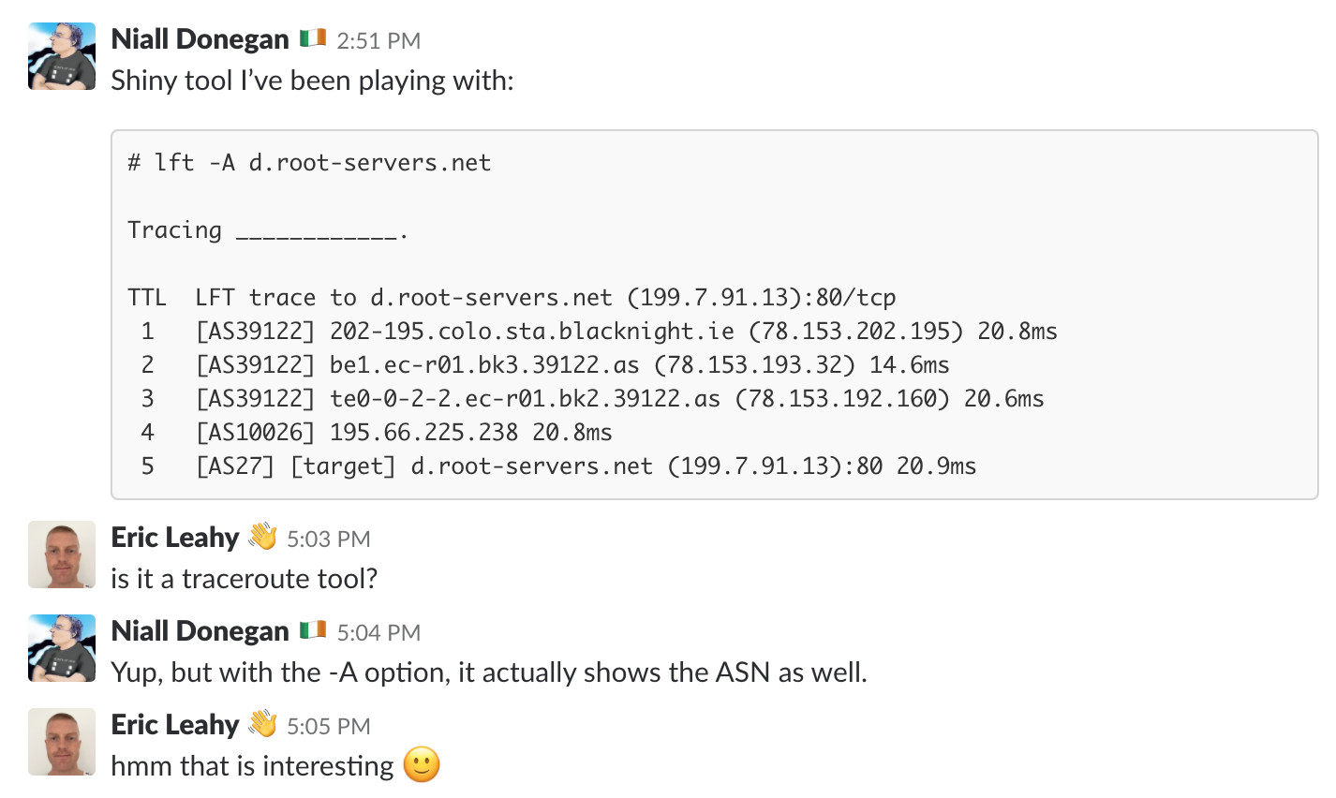
A simple idea

Slide 26

How to make it look pretty?

Slide 27
Daniele

Slide 28
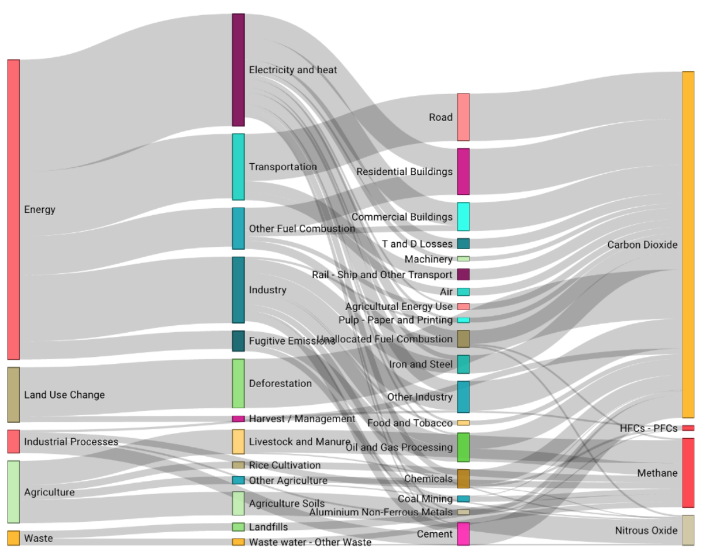
Apache Superset
Looks cool but doesn’t like “loops” in the database, ASN seen more than once is a “loop”!!

Slide 29
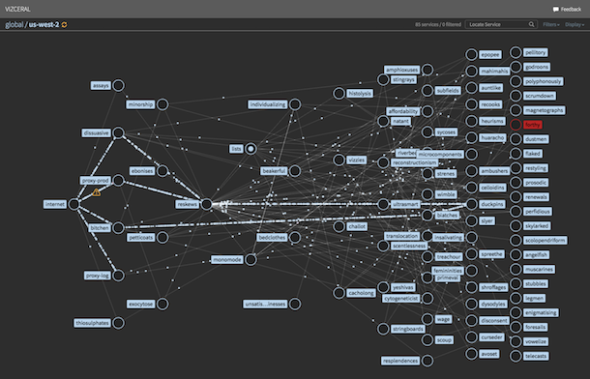
Vizceral
https://medium.com/netflix-techblog/vizceral-open-source-acc0c32113fe

Slide 30

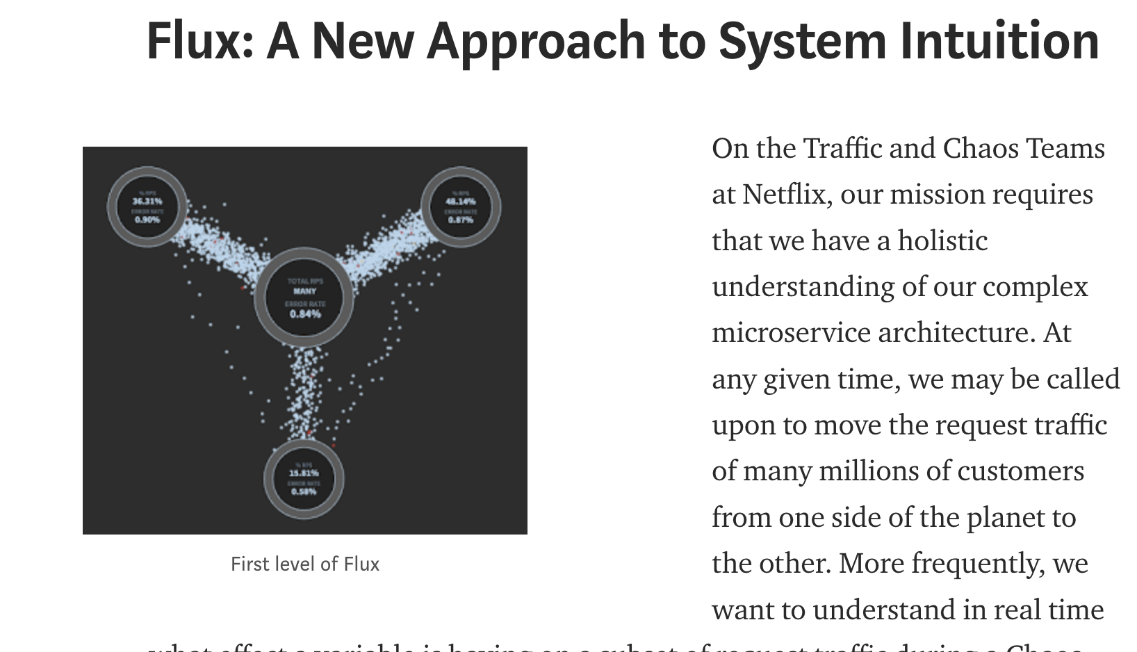
Vizceral
Created by Traffic and Chaos Teams at Netflix.
WebGL Rendering.
Translates JSON into pretty graphs
Unmaintained :’-(

Slide 31
LFT XML output:
lft -r -N -A -S -x -d 443 www.myworkday.com
<lft verbositylevel="0">
<event code="55" begtime="17-Jun-18 17:02:25 IST" />
<event code="9" />
<event code="11" ip="209.177.165.18" protocol="0" protocolname="TCP" dport="443" />
<event code="12" firstholehop="1" lastholehop="1" />
<event code="16" index=" 2" asn="0" net="" ip="10.25.252.129" timems="10.9" />
<event code="16" index=" 3" asn="200451" net="WD-DUBIT" ip="37.0.7.251" timems="10.1" />
<event code="16" index=" 4" asn="6830" net="LGI-UPC" host="089-101-024009.ntlworld.ie" ip="89.101.24.9" timems="7.6" />
<event code="16" index=" 5" asn="6830" net="LGI-UPC" host="ie-dub02a-rc1-ae40-0.aorta.net" ip="84.116.238.114" timems="16.4" />
<event code="16" index=" 6" asn="6830" net="LGI-UPC" host="ie-dub01a-ri1-ae64-0.aorta.net" ip="84.116.134.210" timems="11.6" />
<event code="16" index=" 7" asn="6830" net="LGI-UPC" host="dbln-t2core-a-ae-0-0.aorta.net" ip="213.46.165.2" timems="14.3" />
<event code="16" index=" 8" asn="1299" net="TELIANET" host="ldn-bb3-link.telia.net" ip="62.115.119.242" timems="102.3" />
<event code="16" index=" 9" asn="1299" net="TELIANET" host="ash-bb3-link.telia.net" ip="80.91.246.68" timems="98.9" />
<event code="16" index="10" asn="1299" net="TELIANET" host="ash-b1-link.telia.net" ip="80.91.248.157" timems="98.3" />
<event code="16" index="11" asn="1299" net="TELIANET" host="globalcomm-ic-325543-ash-b1.c.telia.net" ip="62.115.156.161" timems="116.0" />
<event code="16" index="12" asn="18465" net="WORKDAY-01" ip="209.177.165.199" timems="115.3" />
<event code="16" index="13" asn="18465" net="WORKDAY-01" trgstate="open" ip="209.177.165.18" port="443" timems="133.8" />
<event code="21" />
</lft>

Slide 32
Vizceral JSON input:
[..]
"renderer": "focusedChild",
"name": "WD-DUBIT",
"maxVolume": 100,
"updated": 1529251511,
"nodes": [
{
"renderer": "focusedChild",
"name": "37.0.7.251",
"displayName": "WD-DUBIT",
"maxVolume": 100,
"notices": [
{
"title": "AS 200451 37.0.7.251",
"subtitle": "WD-DUBIT"
},
{
"title": "13.8ms"
}
],
"class": "normal",
"metadata": {
"timems": 13.8,
"severity": 0,
"probes": 0
}
}
[..],

Slide 33
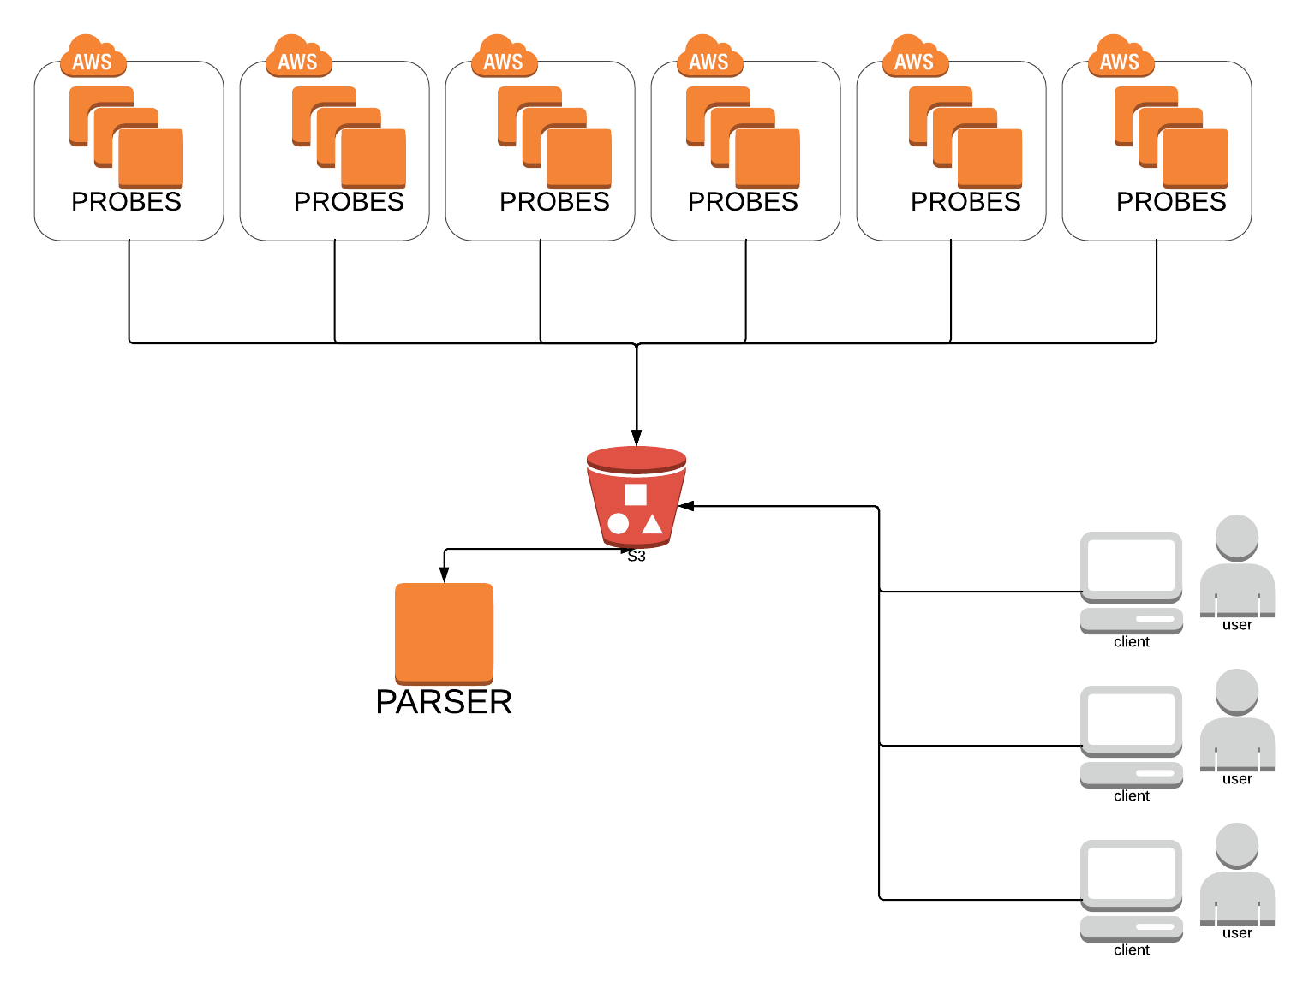

Slide 34


Slide 35

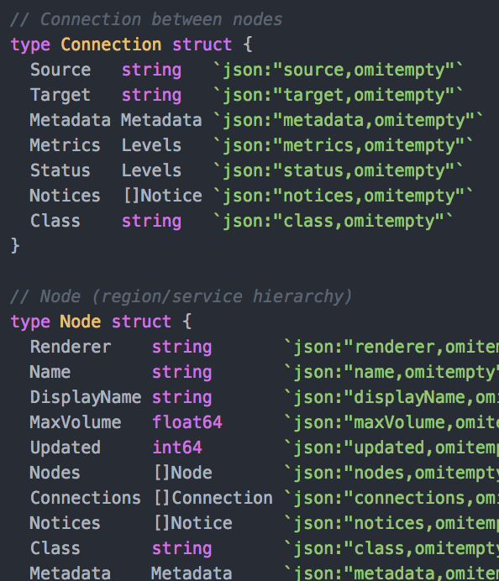
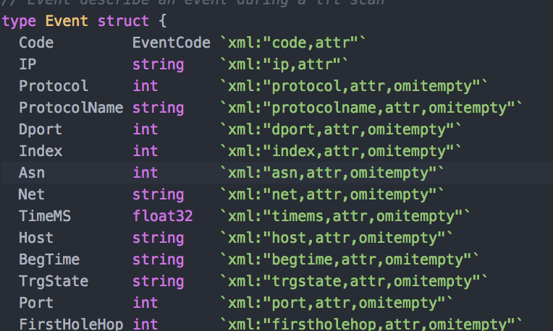
Probe:
Run LTF
Grab XML
Translate to Vizceral
Push to S3
Parser:
Grab all Vizceral graphs
Merge them together
Render final JSON for webapp

Slide 37
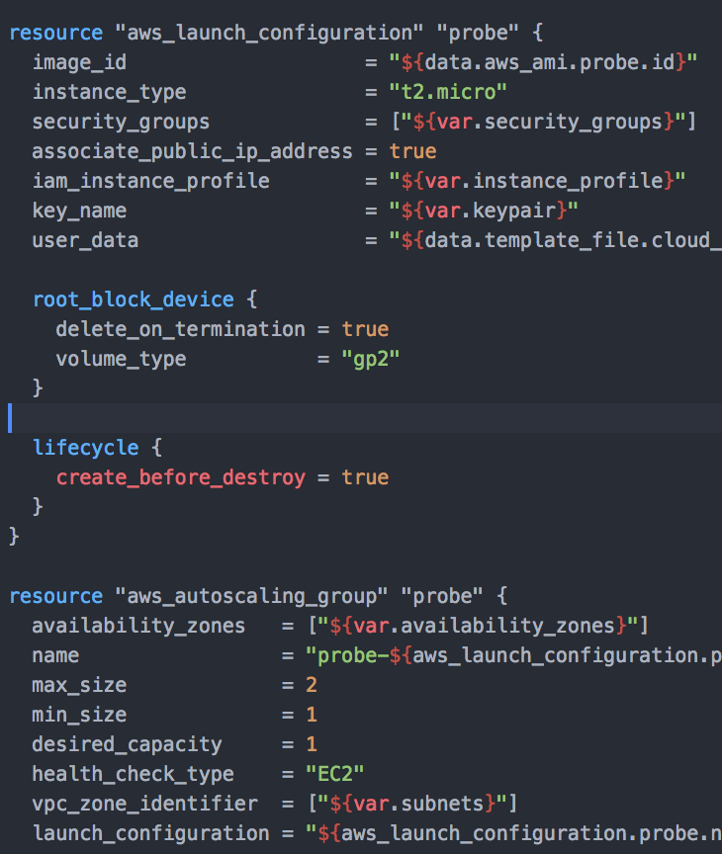

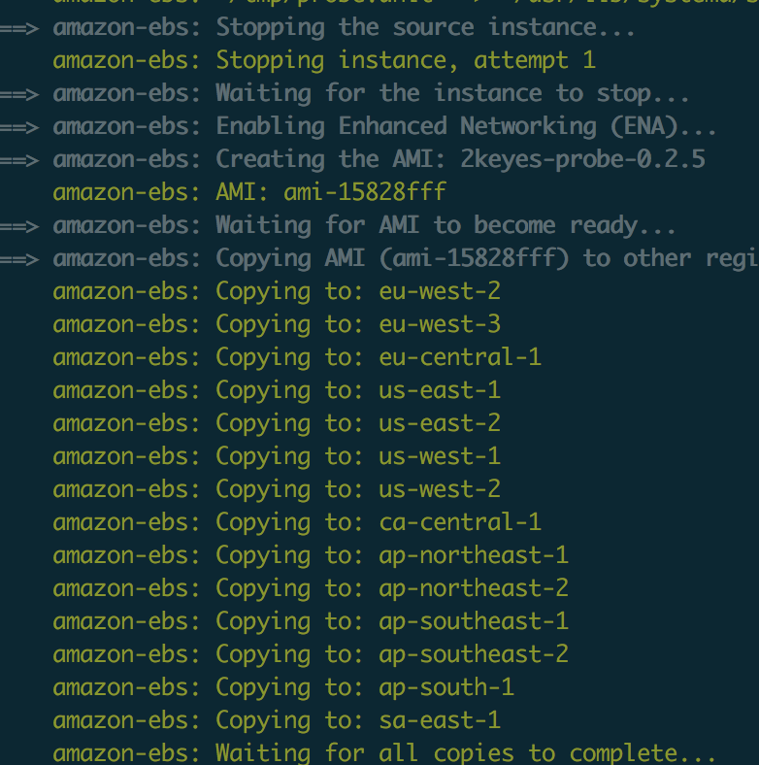


Terraform All The things!
14 Regions
Avg deploy time ~150s

Slide 38


Vizceral Webapp
Uses React Wrapper
Based on Example app from github :D
UI is hard!

Slide 39
DEMO!

